Slide 1
Data and attribute
Beiyu Lin

Slide 2
Review
What is Data Mining?
Why Data Mining is important?
Data Mining and its Applications
Real Life Examples
Notes:
Data science is the application of computational and statistical techniques to address or gain insight into some problem in the real world.
Computational
Statisticals
Real world problems

Slide 3
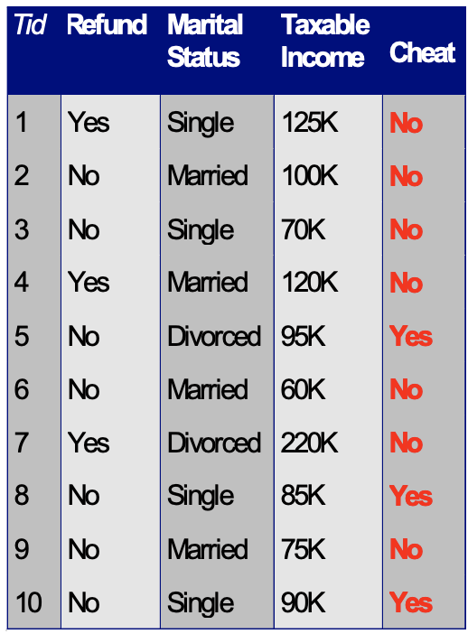
What is DATA
A collection of data objects and their attributes
An attribute is a property or characteristic of an object
– Examples: age, gender, income of a person
– also known as variable, field, characteristic, dimension, or feature
An object is described by a collection of attributes
– also known as record, point, case, sample, entity, or instance

Slide 4
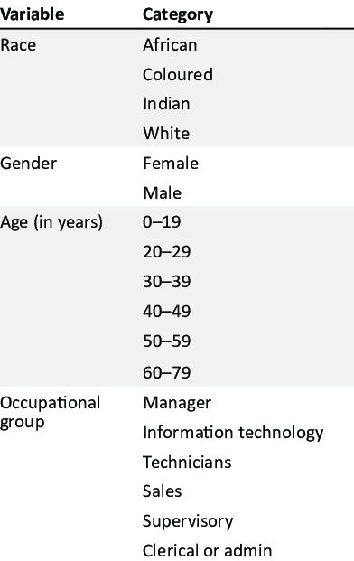
Attribute Values
Attribute
Attribute values
numbers or symbols assigned to an attribute for a particular object
Attributes and attribute values
– Same attribute can be mapped to different attribute values
Example: occupational group can be measured in sales or technicians
– Different attributes can be mapped to the same set of values

Slide 5
Types of Attributes
– Nominal
Examples: ID numbers, zip codes
– Ordinal
Examples: rankings
taste of red wine on a scale from 1-10; grades (A, A-, B+, B, B-, …);
– Interval
Examples: calendar dates.
– Ratio
Examples: elapsed time (e.g., time to go to school)
Notes:
August 2021: from 1st to 31st;
-40 to 100

Slide 6
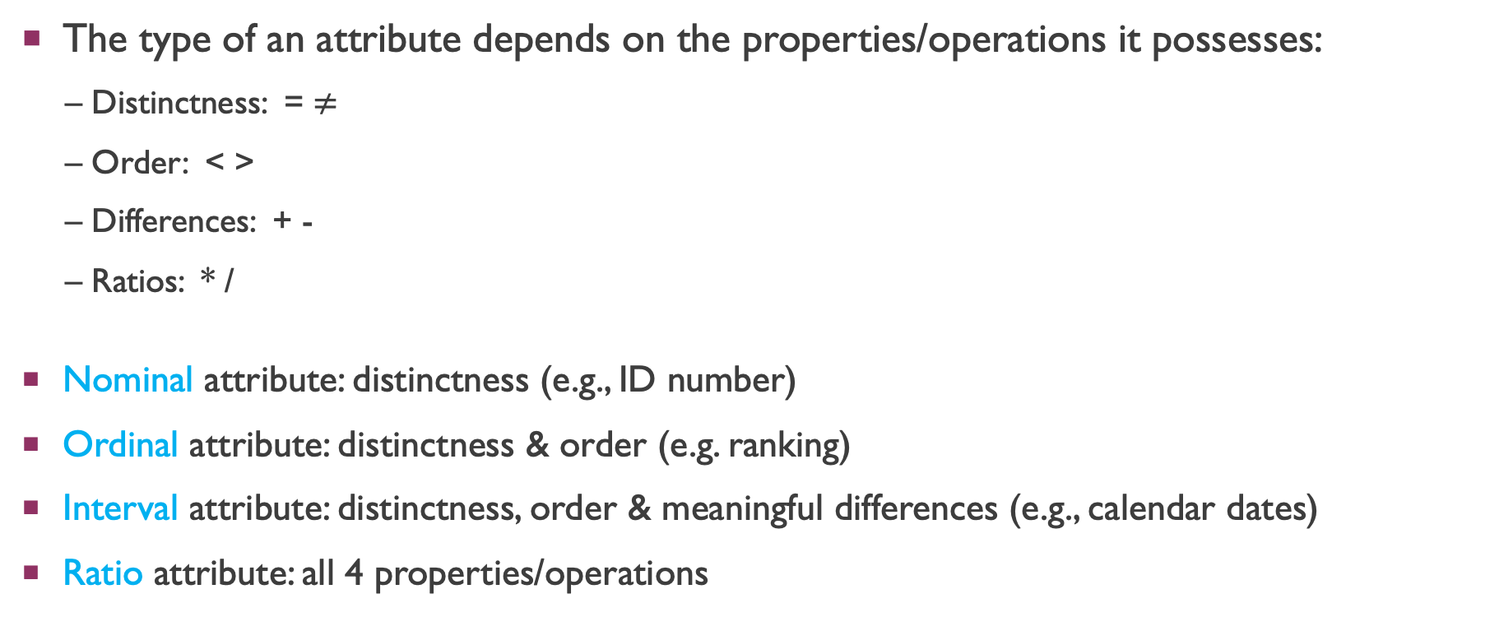
Properties of Attribute Values
The type of an attribute depends on the properties/operations it possesses:
– Distinctness: = $≠$
– Order: < >
– Differences: + -
– Ratios: * /
Nominal attribute: distinctness (e.g., ID number)
Ordinal attribute: distinctness & order (e.g. ranking)
Interval attribute: distinctness, order & meaningful differences (e.g., calendar dates)
Ratio attribute: all 4 properties/operations

Slide 7
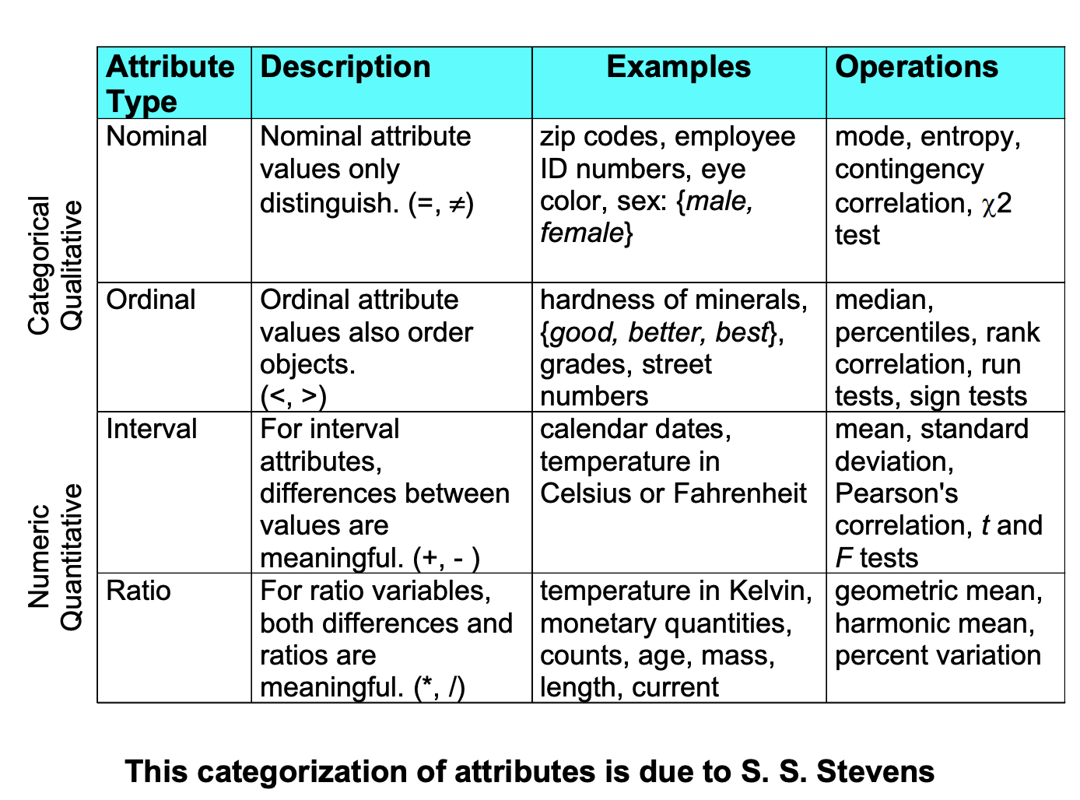
Attribute

Slide 8
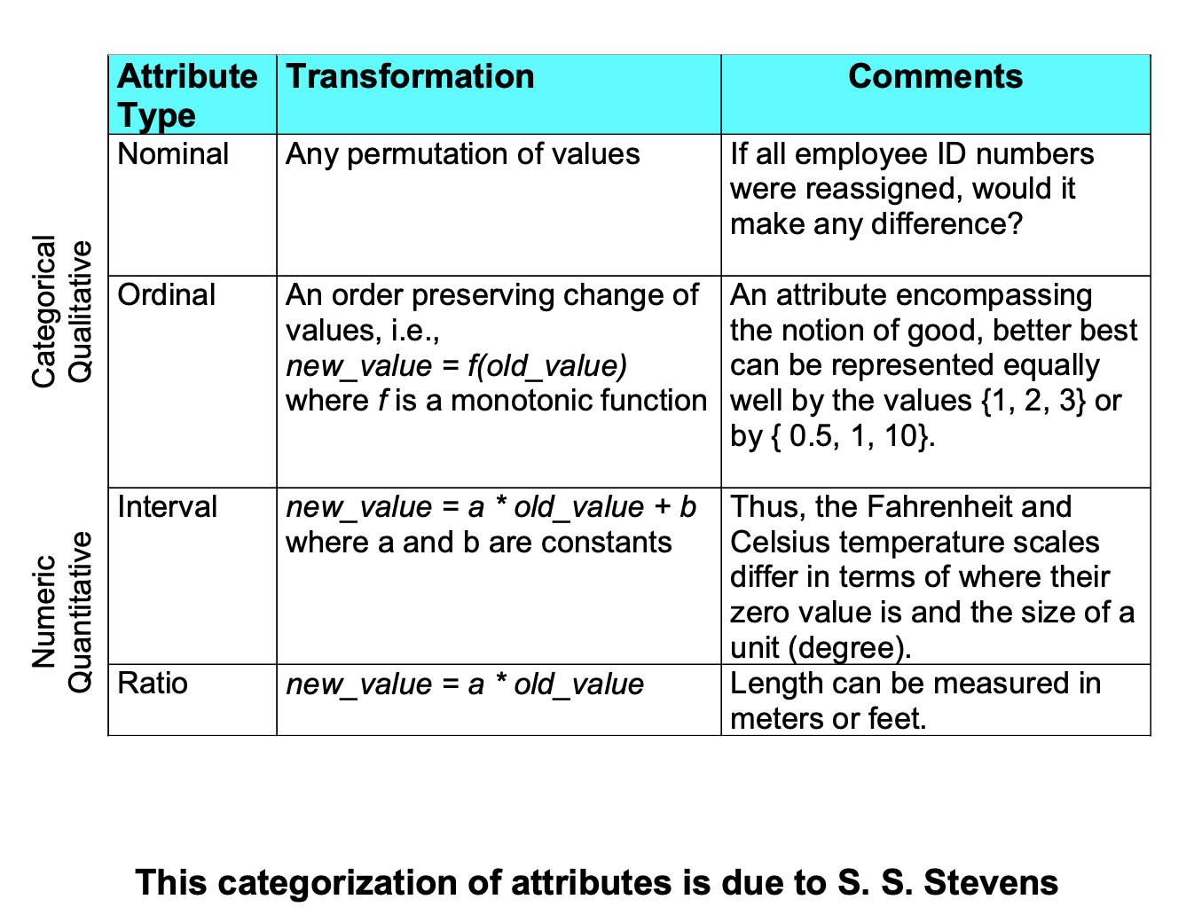
Attribute

Slide 9
Discrete and Continuous Attributes
Discrete Attribute
– a finite or countably infinite set of values
– Examples: a set of eye colors (blue, green, black, brown…)
– Often represented as integer variables (e.g., 0, 1, 2, ..).
– Note: binary attributes are a special case of discrete attributes (e.g., 1 or 0)
Continuous Attribute
– Has real numbers as attribute values (e.g., heights: 5.4, 6.3, etc)
– Examples: temperature, height, or weight.
– Continuous attributes are typically represented as floating point variables ( weight: 111.5 pounds)

Slide 10
Critiques of the attribute categorization
Incomplete
– Partially ordered (e.g. missing values)
– Partial membership
– Asymmetric binary
– Cyclical (e.g., daily routines)
– Multivariate
– Relationships between the data (auto-correlations; not independent; not from an identical distribution)
Real data is approximate and noisy
– may not recognize the proper attribute types
– approximate one attribute type by another

Slide 11
Key Messages for Attribute Types
Choose the operations that are “meaningful” for the type of data
– distinctness, order, intervals, and ratios are only four properties of data
– the data type you see
– may not capture the full information or may suggest hidden properties
– analysis may depend on other properties of the data (e.g., many statistical analyses depend only on the distribution)
– it may vary in different domains.

Slide 12
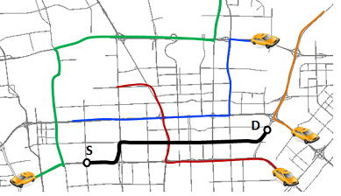
Important Characteristics of Data
Dimensionality (number of attributes) -- high dimensional data brings some challenges
(e.g., using genes as attribute while studying health related problems)
Sparsity -- only presence counts
(e.g., the GPS based traffic trajectory data)
Resolution – patterns depend on the scale
Size of data

Slide 13
Types of data sets
Record
– Data Matrix
– Document Data
– Transaction Data
Graph
– World Wide Web
– Molecular Structures
Ordered
– Spatial Data
– Temporal Data
– Sequential Data (e.g., IoT data)
– Genetic Sequence Data

Slide 14
Record Data
a collection of records, each of which consists of a fixed set of attributes

Slide 15
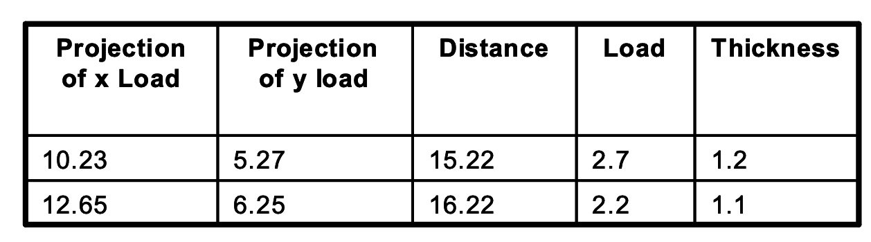
Data Matrix
with same fixed set of attributes and multiple objects.
data set can be represented by an m (rows) by n (columns) matrix

Slide 16
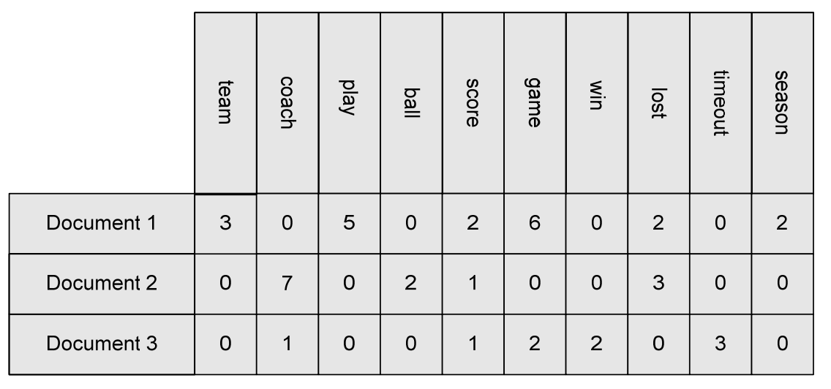
Document Data
Each document becomes a ‘term’ vector (or word-based)
– each term/word is an attribute of the vector
– the value of each attribute is the number of times this term / word occurs in the document.

Slide 17
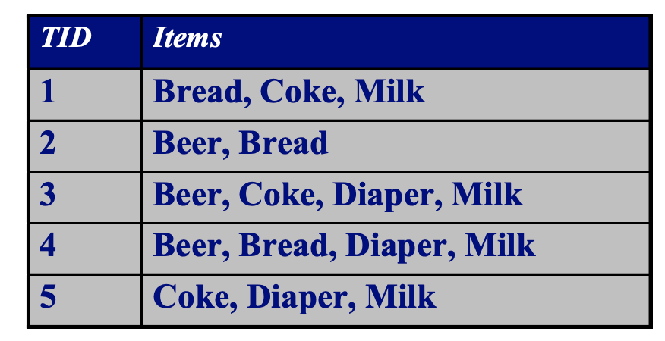
Transaction Data
A special type of data, where
– each transaction involves a set of items.
– for example, a person went for a grocery shopping.
a. the set of products purchased is a transaction,
b. the individual products that were purchased are the items.
– can also represented as record data

Slide 18
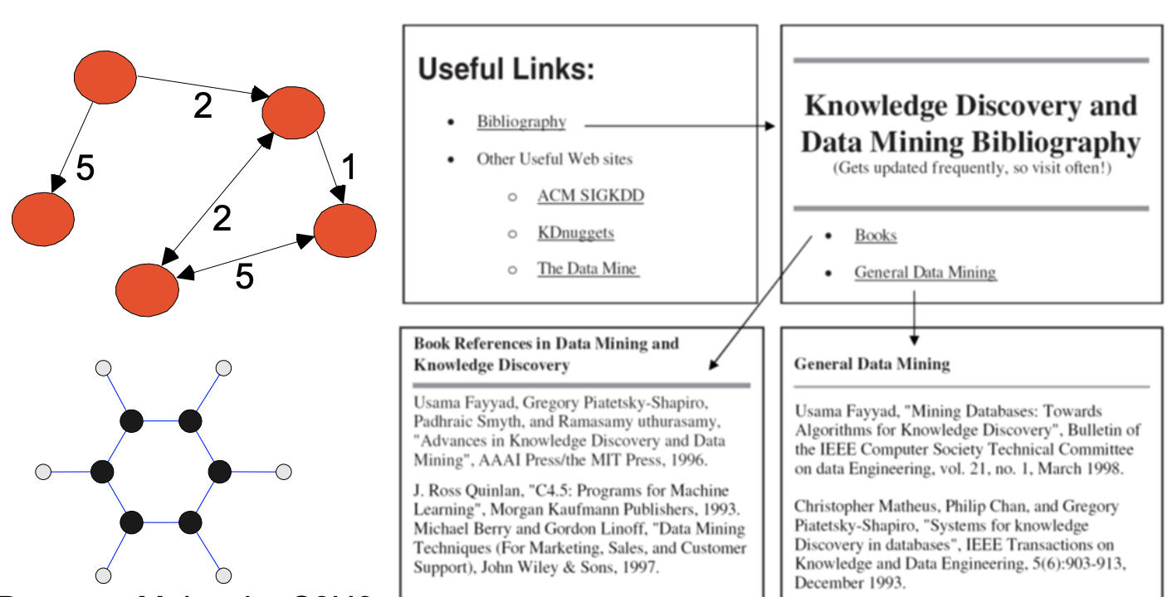
Graph Data
Examples: Generic graph, a molecule, and webpages

Slide 19
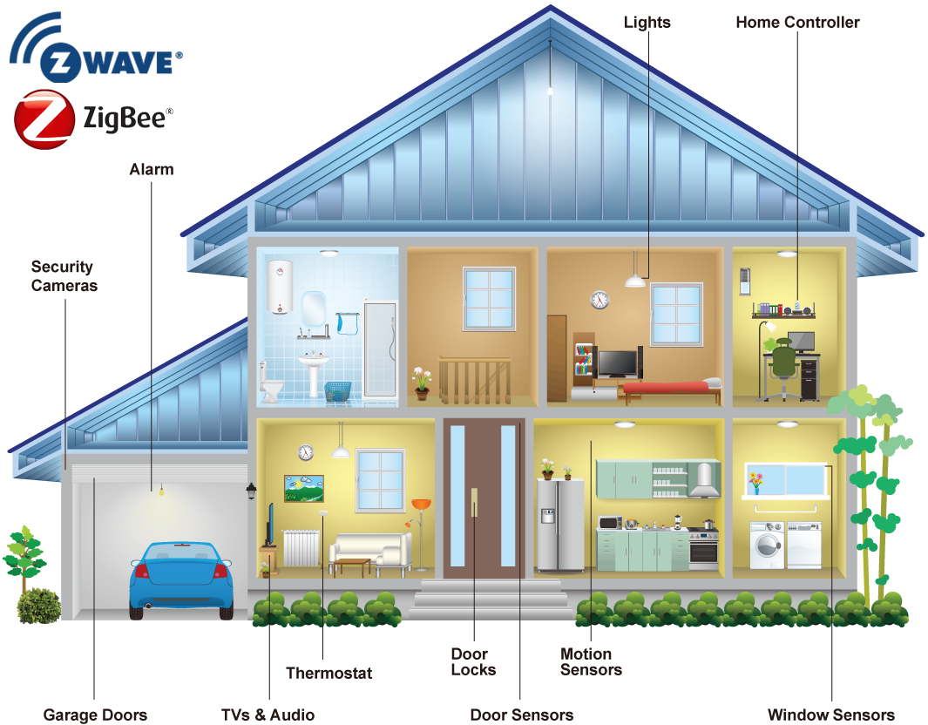
IOT DATA
Sensor types: infrared motion(narrow/wide-area), ambient light, magnetic, and temperature sensors.
2011-06-13 | 21:48:43 | Bathroom | ON | Personal_Hygiene
2011-06-13 | 21:48:44 | Bathroom | OFF | Personal_Hygiene
2011-06-13 | 22:47:02 | Bedroom | ON | Personal_Hygiene
2011-06-13 | 22:47:04 | Bedroom | OFF | Sleep
2011-06-13 | 22:47:06 | Bedroom | ON | Sleep
………………
2011-06-14 | 10:11:24 | Kitchen | ON | Wash_Dishes
2011-06-14 | 10:11:25 | Kitchen | OFF | Wash_Dishes
2011-06-14 | 10:11:40 | Kitchen | ON | Cook
2011-06-14 | 10:11:41 | Kitchen | OFF | Wash_Dishes
imgbin.com

